Slide 1

Unlocking Insights in Calgary Child Care Program Compliance: An Analytical Approach
Group 39
Sri Harsha Tuttaganti
Venkateshwaran Balu Soundararajan

Slide 2

Introduction
Childcare is essential for early childhood development.
Provides a foundation for learning, socialization, and well-being.
High-quality childcare significantly impacts a child's growth and future success.

Slide 3


Objective
Utilize the Calgary Childcare Information dataset.
Analyze licensed childcare programs.
Focus on capacity, compliance status, and inspection history.
Ensure high standards of care for children in Calgary resources.
Target Audience
Parents: Searching for reliable childcare options.
Researchers: Analyzing childcare availability and distribution.
Policymakers: Evaluating childcare needs and planning

Slide 4
Child Care Information Dataset
Overview
Dataset Name: Child Care Information
Source: City of Calgary Open Data Portal
Description: This dataset provides information about licensed Child Care facilities in Calgary. It includes details such as facility names, locations, types of care offered, capacity, and contact information. (2014-2023)
https://data.calgary.ca/Health-and-Safety/Child-Care-Information/qdxh-qngy/about_data

Slide 5
Data Fields and Its Significance
Field Name | Data Type | Significance
Program Name | Text | Uniquely identifies each program
Type of Program | Text | Categorizes programs for analysis
Program Address | Text | Provides location details
Program City | Text | Identifies the city for location-based analysis
Postal Code | Text | Used for geographic and demographic analysis
Phone Number | Text | Provides a means of contact for inquiries
Capacity | Number | Indicates the program's scale and capacity
Inspection Date | Floating Timestamp | Tracks the timeline of inspections
Inspection Reason | Text | Provides insights into compliance and regulatory focus areas
Non Compliance | Text | Assesses compliance status and identifies areas needing improvement
Enforcement Action | Text | Details corrective actions implemented
Remedy Date | Floating Timestamp | Tracks deadlines for resolving non-compliance issues

Slide 6
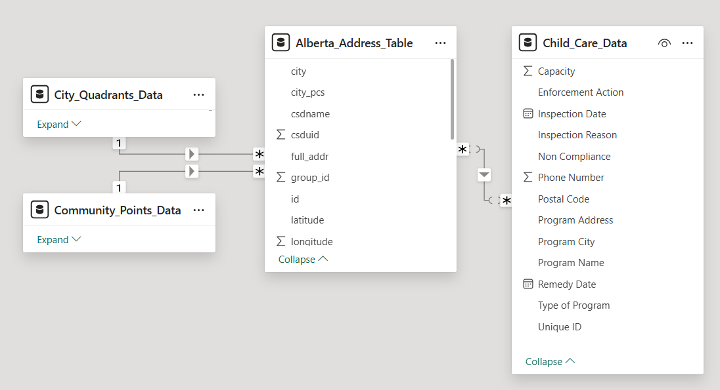

Data Model with Supporting Datasets

Slide 7


Data Cleaning and Transformation
Step 1 : Cleaned the data by removing duplicate values.
Step 2 : Added a dataset containing latitude and longitude information.
Step 3 : Removed duplicates caused by merging location dataset.
Step 4 : Addressed normalization issues by cross-checking addresses in both datasets and rectifying discrepancies.
Step 5 : Added another dataset to group data into communities and Quadrants.

Slide 8
Data Preprocessing- Iterative Imputation
Step 1: Removed rows containing null values
Created a cleaned dataset by removing rows with null values.
Step 2: Split the cleaned dataset
Divided the cleaned dataset into test (20%) and train (80%) datasets.
Step 3: Applied iterative imputation using random forest
Used the random forest model for iterative imputation to predict missing values.
Step 4: Integrated the predicted values
Integrated the predicted values back into the original dataset.
Step 5: Performed imputation on specific columns
Applied the imputation process on the "Program Name" and "Type of Program" columns.
Type of Program column:
Accuracy: 0.9126
Program Name column:
Accuracy: 0.9517

Slide 9
GUIDING QUESTIONS
7
Program Types
1004
Unique Programs
14
Inspection Types

Slide 10
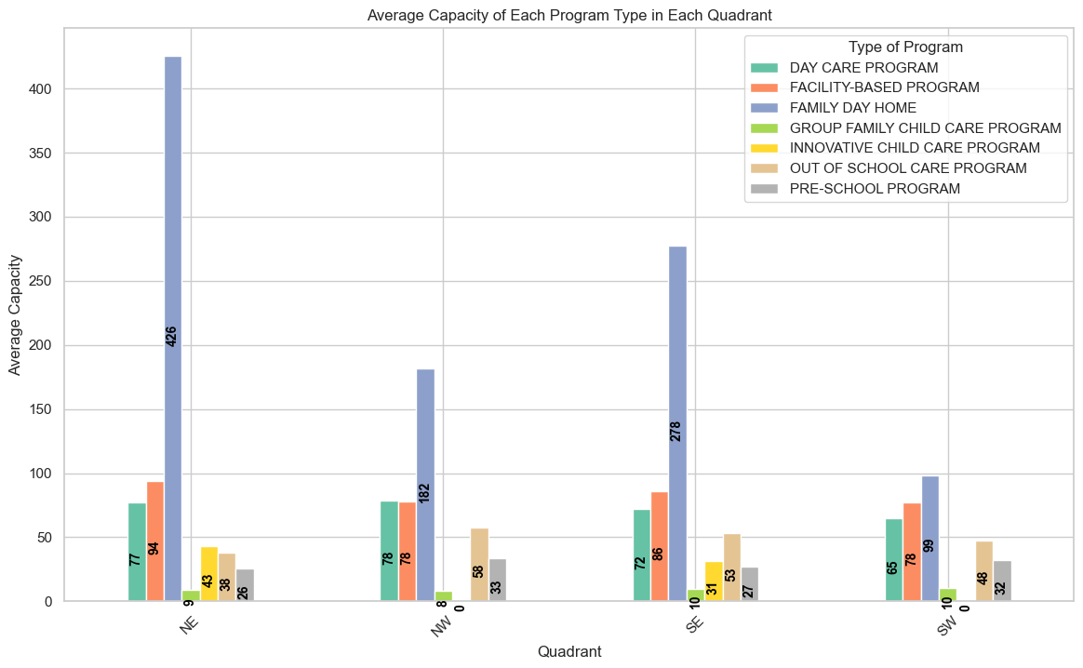
Program Types and its distribution in Calgary
What is the average capacity of child care programs by its types, how does it vary by its Quadrant
Insights:
Highest Average Capacity: Across all quadrants, the FAMILY DAY HOME program consistently has the highest average capacity, indicating its dominance in each region.
Variation Across Quadrants: The average capacity of program types varies significantly across different quadrants.
Program Diversity: Each quadrant offers a mix of program types, with notable variation in their capacities.

Slide 11
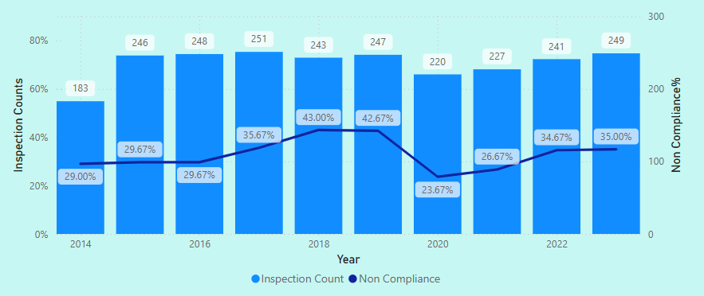
Year on Year Inspections and its Non- Compliance Trends
How do the average number of inspections and the rate of non-compliance change year-on-year across different childcare programs in Calgary?
Insights:
2016-2019 Increase: There was a noticeable increase in non-compliance percentages from 2016 to 2019.
2020 Dip: Both inspection counts and non-compliance percentages dipped significantly in 2020.
Post-2020 Recovery: There was a recovery in inspection counts post-2020, but non-compliance percentages remain fluctuating.

Slide 12
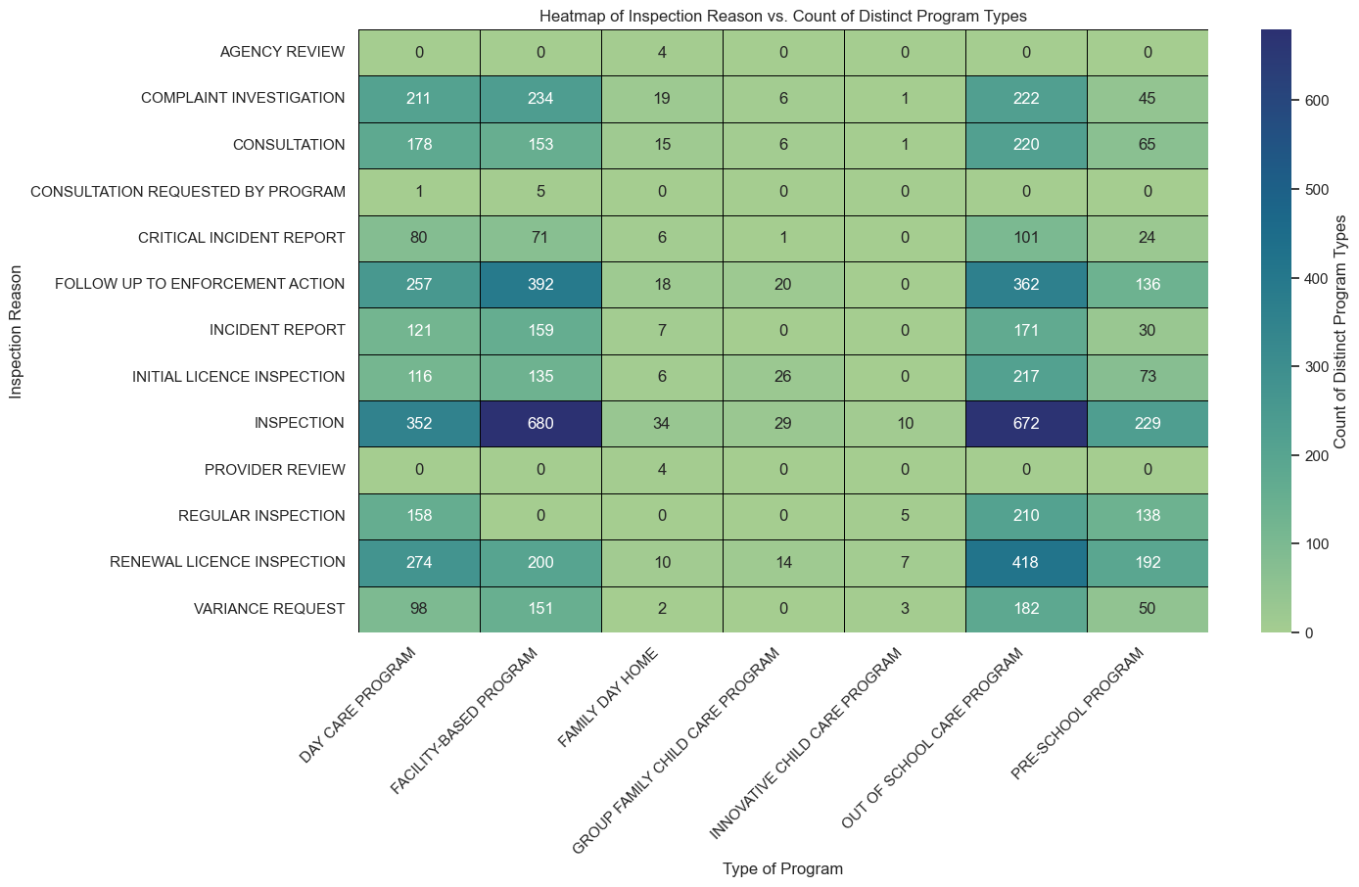
Inspections Reasons frequency with Program Type
What are the most common reasons for inspections across different types of childcare programs in Calgary?
Insights:
High-Frequency Inspections: INSPECTION and COMPLAINT INVESTIGATION are common across most program types, indicating regular oversight and response to complaints.
Program-Specific Trends: Certain program types like Facility-Based Programs and Family Day Homes are more frequently inspected.
Focus Areas: The high counts in FOLLOW UP TO ENFORCEMENT ACTION and RENEWAL LICENCE INSPECTION suggest these are critical areas needing close monitoring.

Slide 13
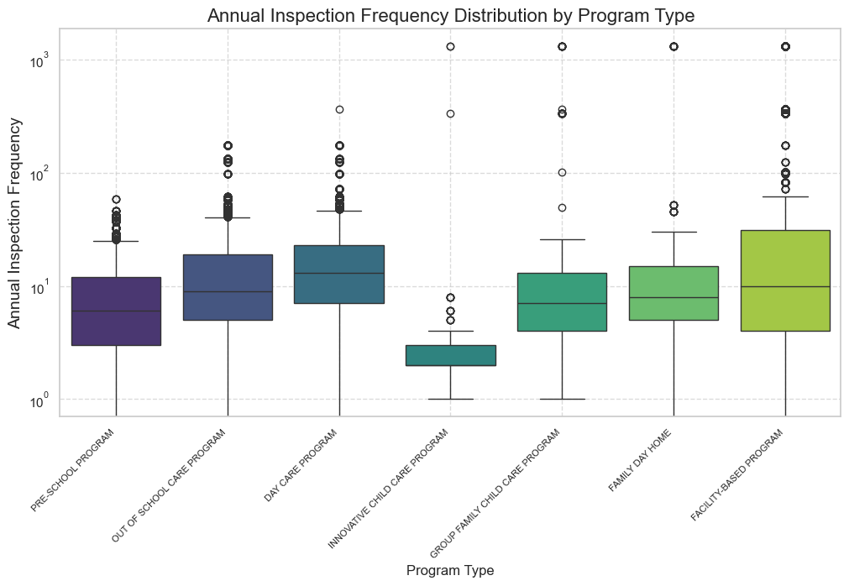
Inspection Frequency (in Days) V/S Program Type
Is there a correlation between the type of childcare program and the frequency of inspections?
Insights:
Frequent Inspections: Innovative Child Care Programs experience more frequent and consistent inspections compared to other program types.
Less Frequent Inspections: Facility-Based Programs have the least frequent and most variable inspection intervals, indicating less regulatory scrutiny.

Slide 14
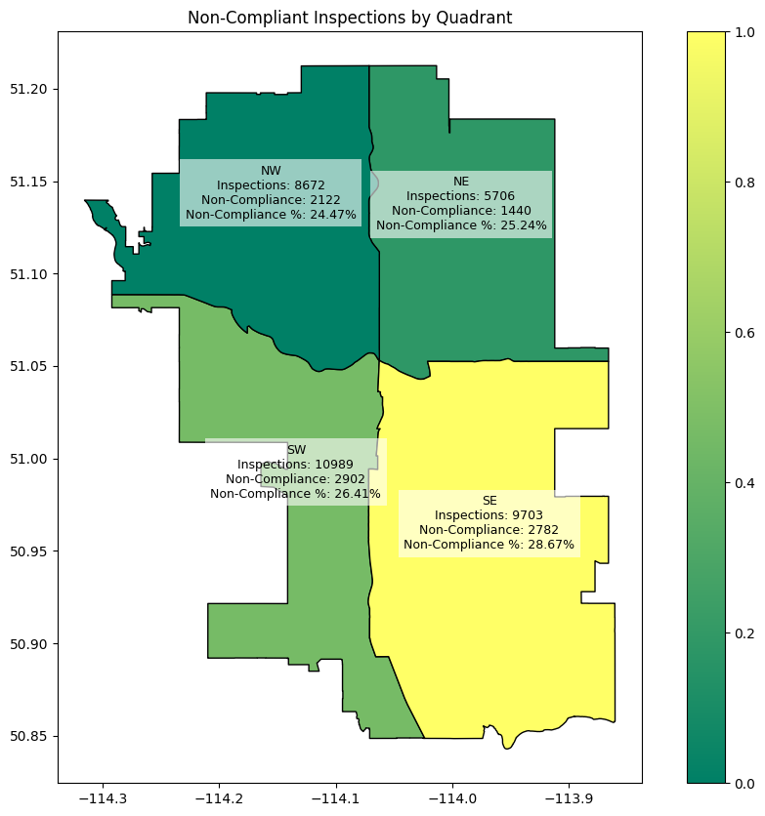
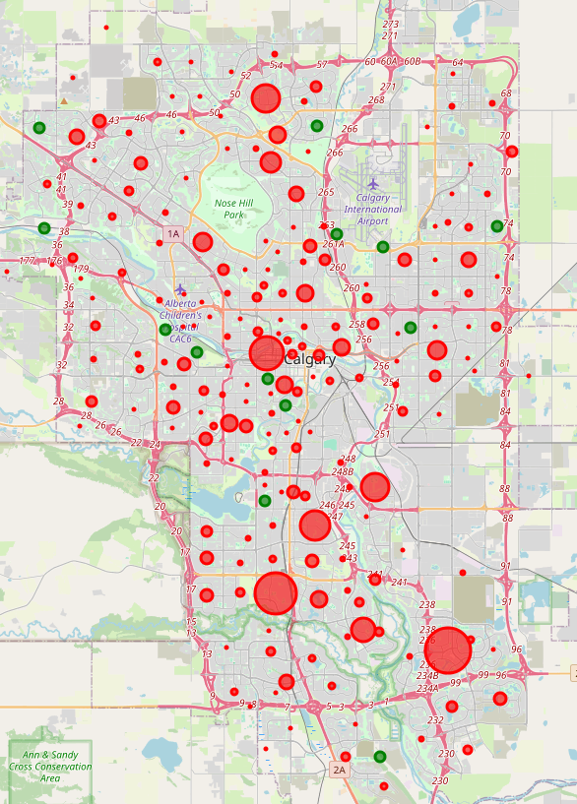
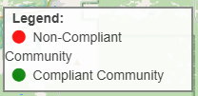
Understanding the Non-Compliance% spread by Quadrant for better Choices
How is the Non-Compliance Spread across the four Quadrants and Communities of the city ?
Insights:
Highest Non-Compliance Rate: The SE (Southeast) quadrant has the highest non-compliance rate at 28.67%, indicating more frequent issues in this area.
Frequent Inspections: The SW (Southwest) quadrant has the highest number of inspections (10,909), highlighting intensive monitoring.

Slide 15
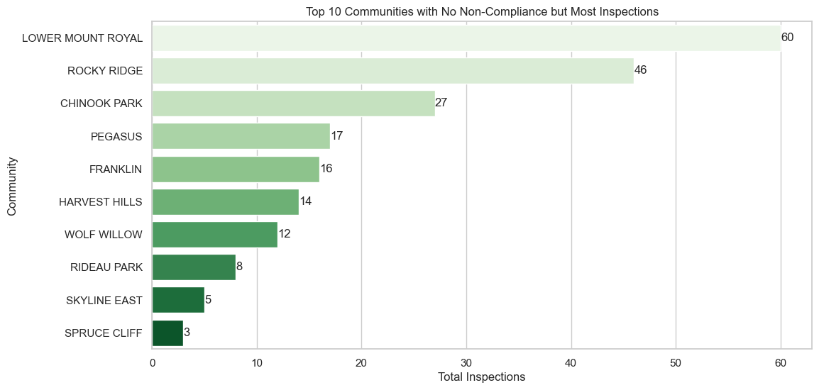
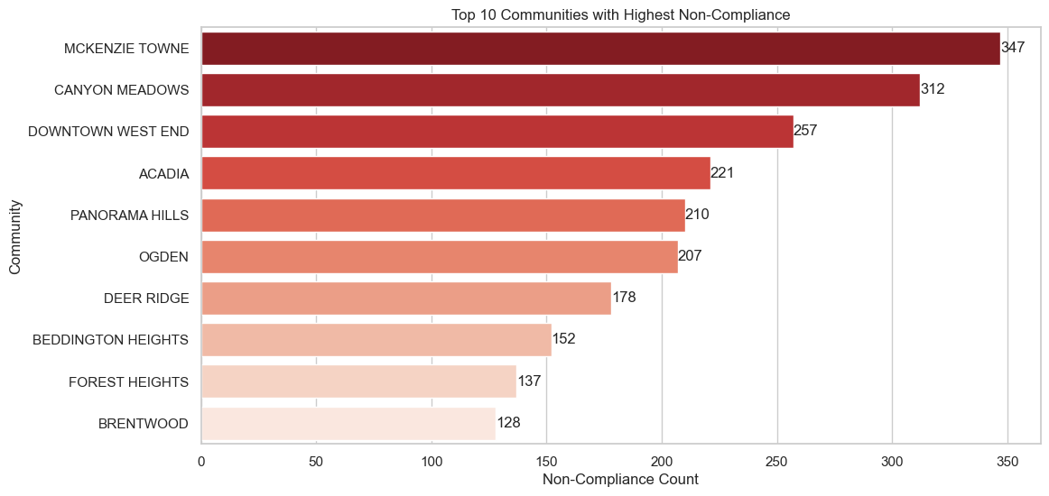
Program Inspections and Non-Compliance against Communities
Identify the Top-10 communities with lowest and highest compliance rates

Slide 16
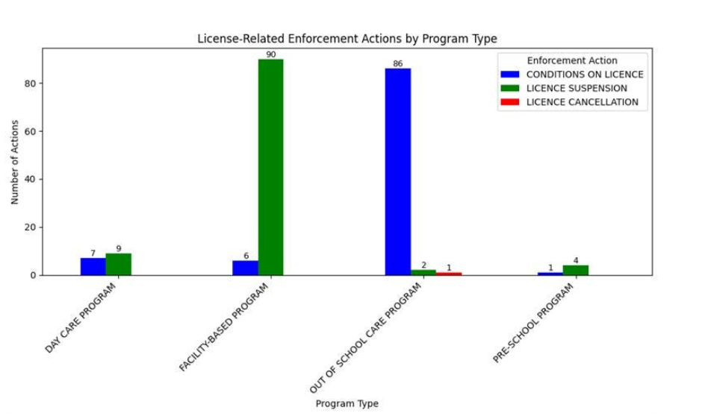
Analyzing Regulatory Compliance –License Cancellation
How does the certain program types or locations have more enforcement actions pertaining to licence cancellation and suspension ?
Insights:
Facility-Based Programs face significant enforcement actions, primarily suspensions.
While Pre-School Programs have the fewest actions, indicating relatively better compliance.
Out of School Care Programs mostly encounter conditions on their licenses.

Slide 17
MACHINE LEARNING

Slide 18
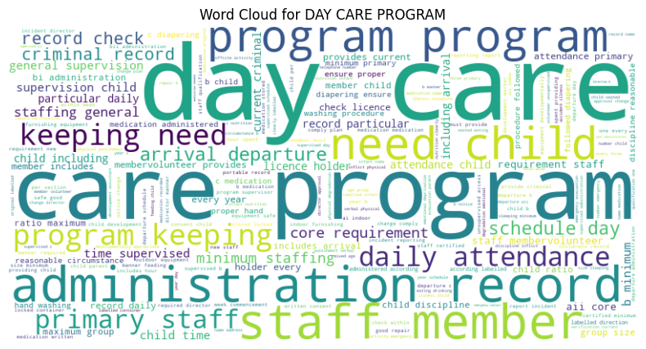
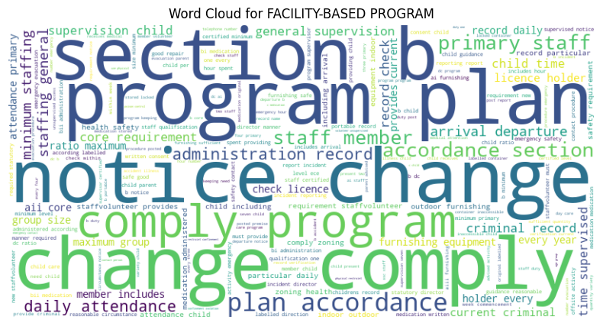
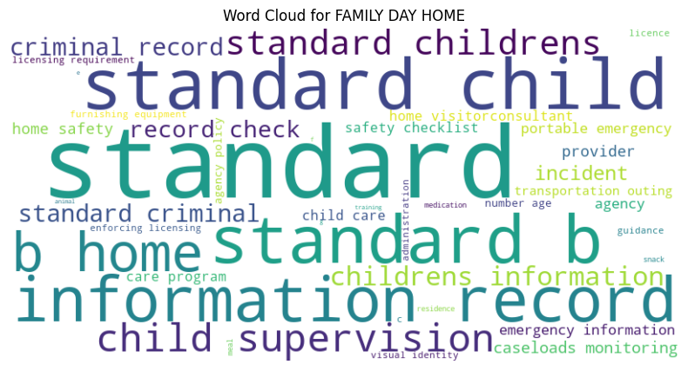
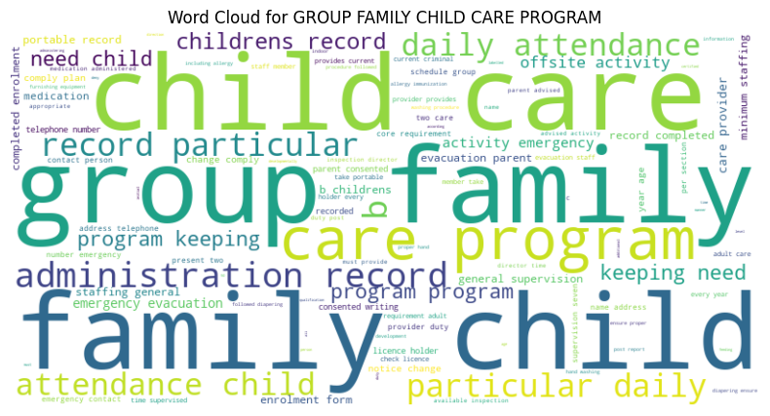
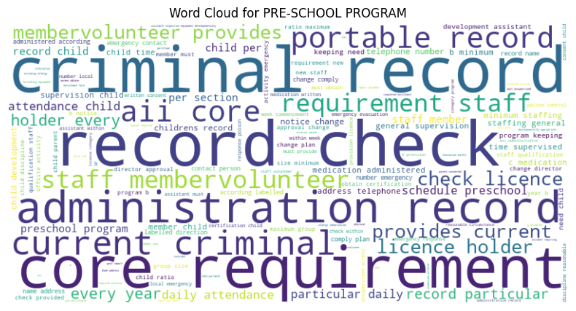

Text Analysis – Identification of Reasons in Non-Compliance Programs
Innovative Childcare Program has no data

Slide 19
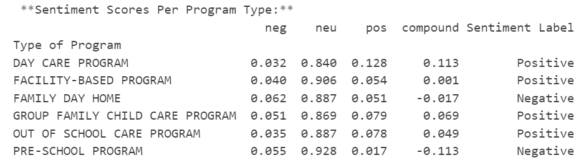
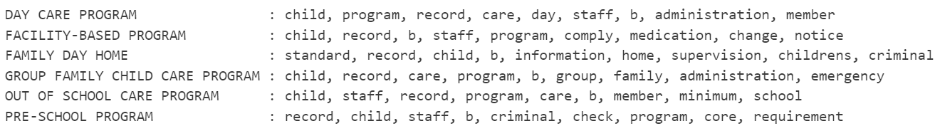
Sentimental Analysis on Non - Compliance
Frequent words used in Programs

Slide 20
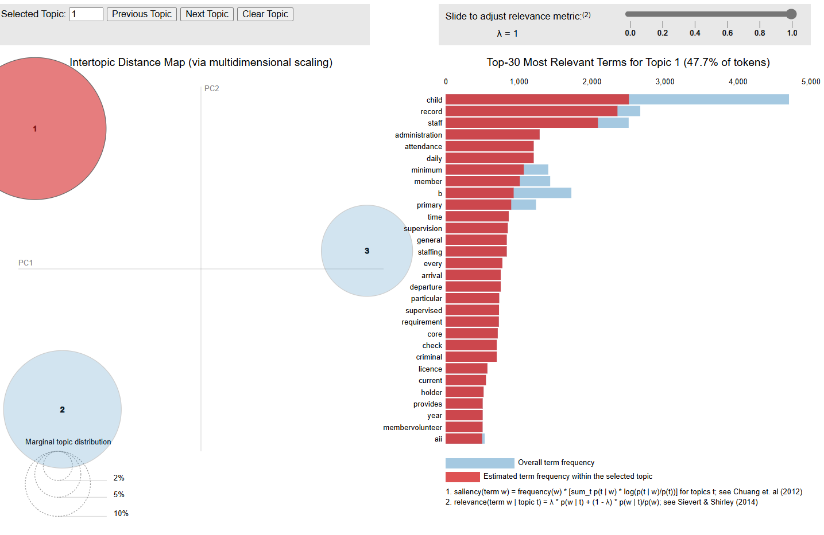
LDA Topic Modeling and its insights on Non-Compliance Reasons
Topic 1: Staffing & Supervision Compliance Issues
Key Terms:
child, record, staff, administration, attendance, supervision, requirement, criminal, licence, holder, check
Non-compliance issues may involve:
Insufficient supervision of children.
Failure to maintain proper attendance records.
Issues with staff qualifications, criminal background checks, and required licensing.
Suggestion:
Childcare program should focus on ensuring qualified, well-trained staff for childcare.

Slide 21
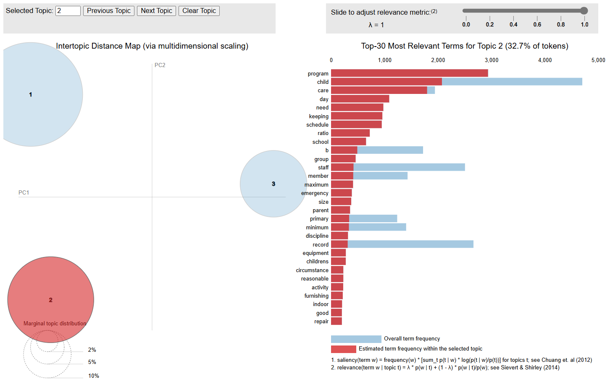
LDA Insights
Topic 2: Childcare Facility & Safety Regulations
Key Terms:
program, child, care, day, keeping, schedule, ratio, school, equipment, children, repair
Non-compliance issues may involve:
Violation of child-to-staff ratios.
Poor maintenance of facilities and equipment.
Failure to follow proper schedules and care programs.
Suggestion:
Childcare should prioritize safety, well-maintained environments for child development.

Slide 22
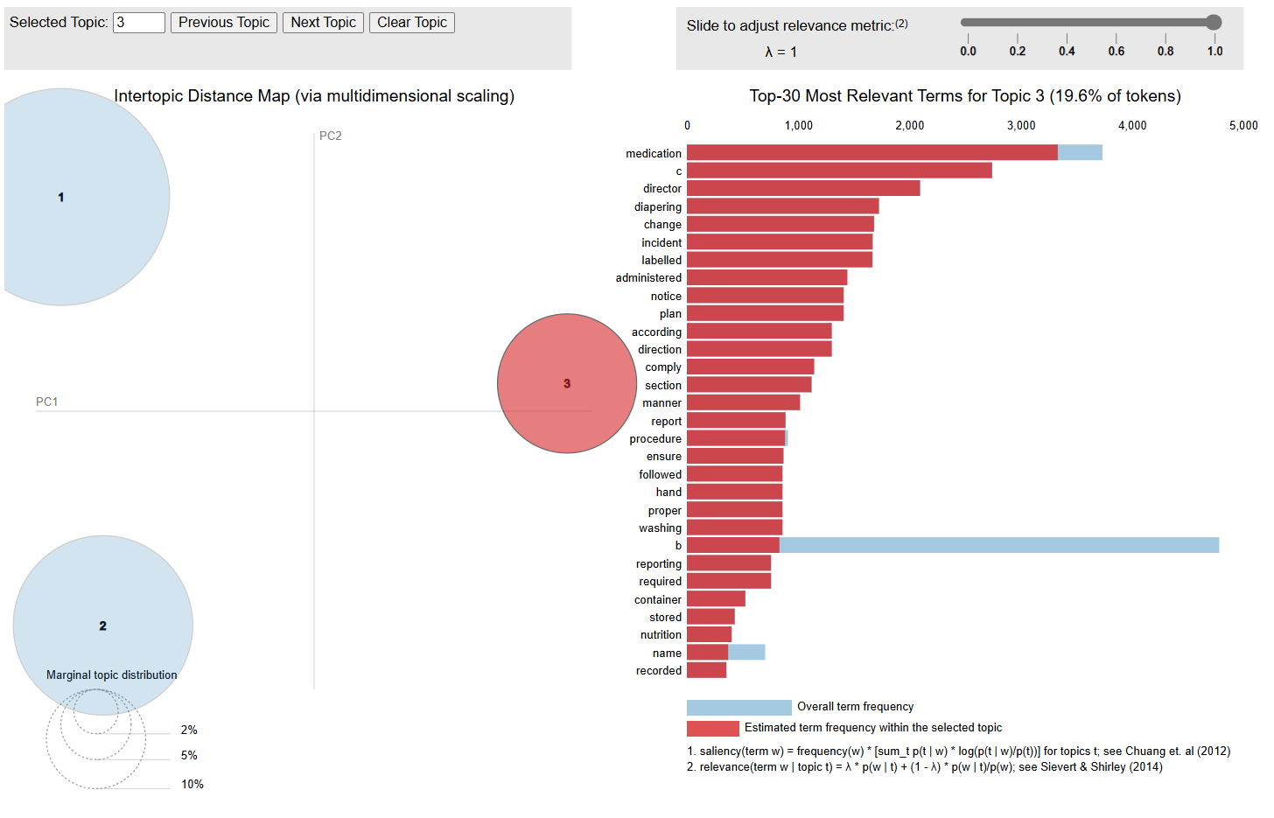
LDA insights
Topic 3: Medication & Hygiene Compliance
Key Terms:
medication, diapering, change, incident, administered, procedure, washing, reporting, nutrition, stored
Non-compliance issues may involve:
Improper storage or administration of medication.
Lack of hygiene standards in diapering and handwashing.
Failure to report incidents related to medication or health.
Suggestion:
This highlights the importance of strict health and safety protocols in childcare environments.

Slide 23
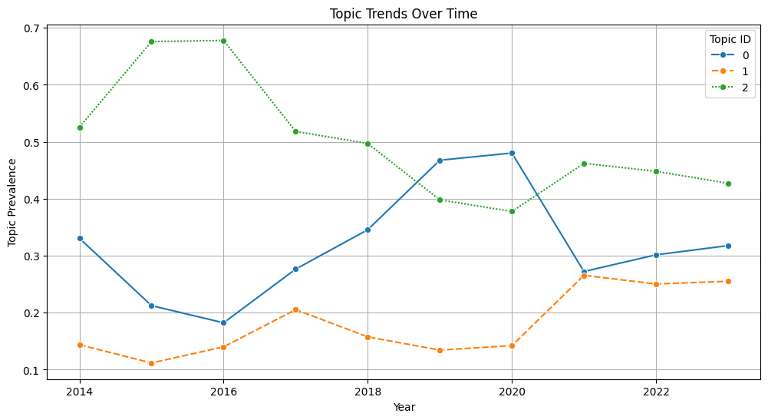
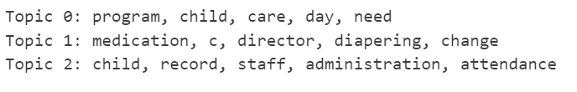
LDA Over the Time
Are there trends or patterns in identified topics over time?

Slide 24
Predictive Analysis of Non-Compliance:
Can we predict non-compliance likelihood based on program attributes and inspection history, and what features indicate compliance status?
Data Preparation
Categorical Encoding
SMOTE
Logistic Regression Model
Binary Target Column: Created a binary target column (Non_Compliance_Indicator) to indicate non-compliance.)
Handling Missing Values: Dropped rows with missing values in selected columns to ensure data quality.
Feature Selection: Selected relevant columns for modeling.
One-Hot Encoding: Used one-hot encoding to convert categorical variables into a format suitable for machine learning algorithms.
Data Splitting: Split the data into training and testing sets.
SMOTE Application: Applied SMOTE (Synthetic Minority Over-sampling Technique) to oversample the minority class..
Training the Model: Trained a logistic regression model on the resampled training data.
Code for Prediction
Code to Encode and Predict

Slide 25
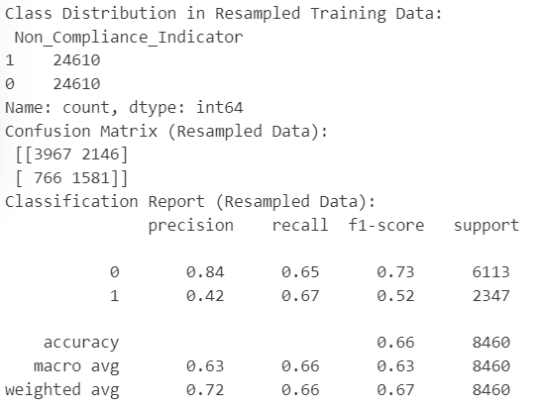
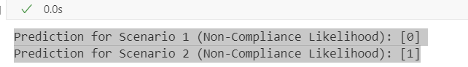
Model Results and Predictions
Prediction Scenarios
Scenario 1: Group Family Child Program
Capacity: 10
Type of Program: Group Family Child Program
Postal Code: T2M3T4
Prediction: [0] Likelihood of Non-Compliance: Unlikely
Scenario 2: Innovative Child Care Program
Capacity: 6050
Type of Program: Innovative Child Care Program
Postal Code: T2M1L9
Prediction: Predicted likelihood of non-compliance.
Prediction: [1] Likelihood of Non-Compliance: Likely

Slide 26
Conclusion
Key Non-Compliance Issues Identified.
Non-Compliance Trends by Quadrant.
Yearly Trends in Non-Compliance & Inspections.
We identified key inspection reasons from LDA model
Predictive Modeling on non-compliance likelihood.
Future Steps
Refine Predictive Models – Improve non-compliance forecasting accuracy.
Policy Recommendations – Use trends to guide better regulations.
Community Engagement – Provide recommendations to Conduct training programs for childcare providers

Slide 27
References
[1] Government of Alberta, "Childcare," Alberta.ca, 2025. [Online]. Available: https://www.alberta.ca/child-care.
[2] City of Calgary, "Communities by Sector," Data Calgary, 2025. [Online]. Available: https://data.calgary.ca/Base-Maps/Communities-by-Sector/e6xg-kaxf.
[3] City of Calgary, "City Quadrants," Data Calgary, 2025. [Online]. Available: https://data.calgary.ca/Base-Maps/City-Quadrants/g8ma-syw.
[4] Statistics Canada, "Open Database of Addresses (ODA)," Government of Canada, 2025. [Online]. Available: https://www.statcan.gc.ca/en/lode/databases/oda.

Slide 28
Thank You!

